Slide 1
right of way plan to construction mountain parkway
Kytc partnering conference
Row & U tracts
September 7, 2016

Slide 2
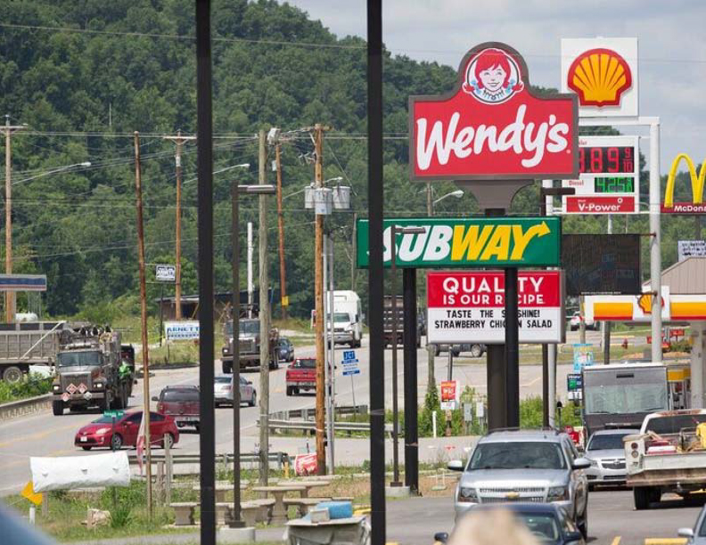
“Restaurant ROW” Section of Mountain Parkway Expansion

Slide 3
Tiger 2014 Funding Application

Slide 4
Application delivery schedule

Slide 5
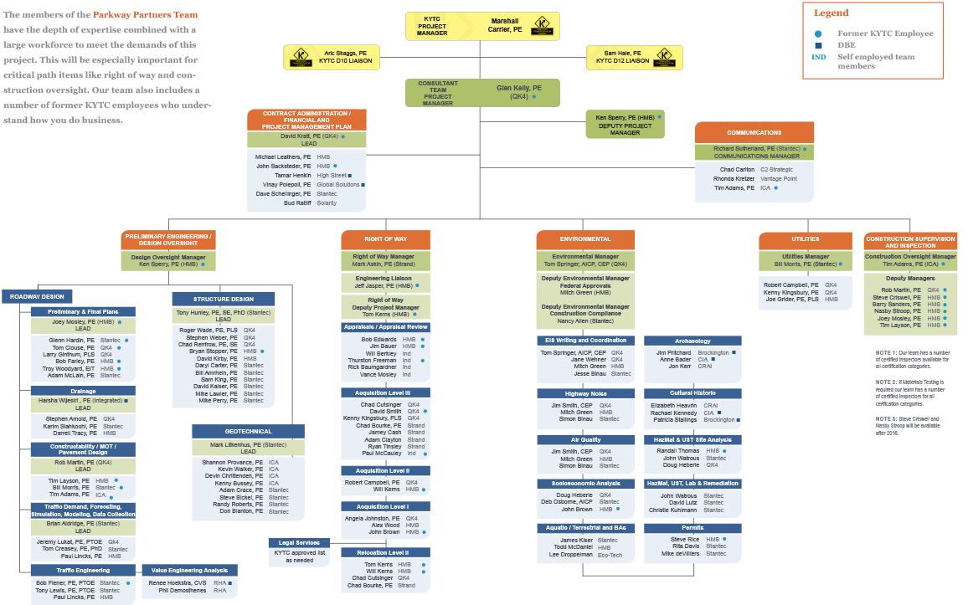

Slide 6
Project overview

Slide 7
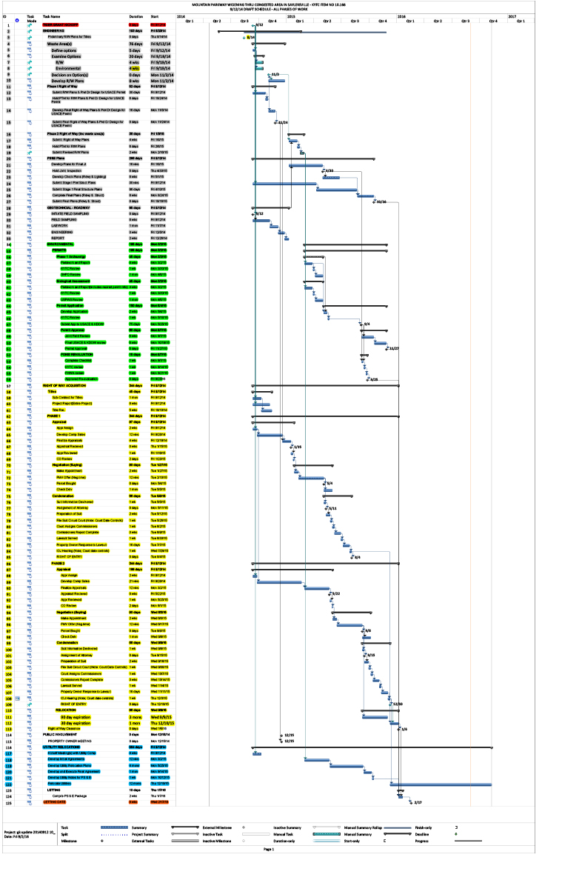
Initial delivery schedule September 12, 2014 Tiger “Kickoff” Meeting

Slide 8
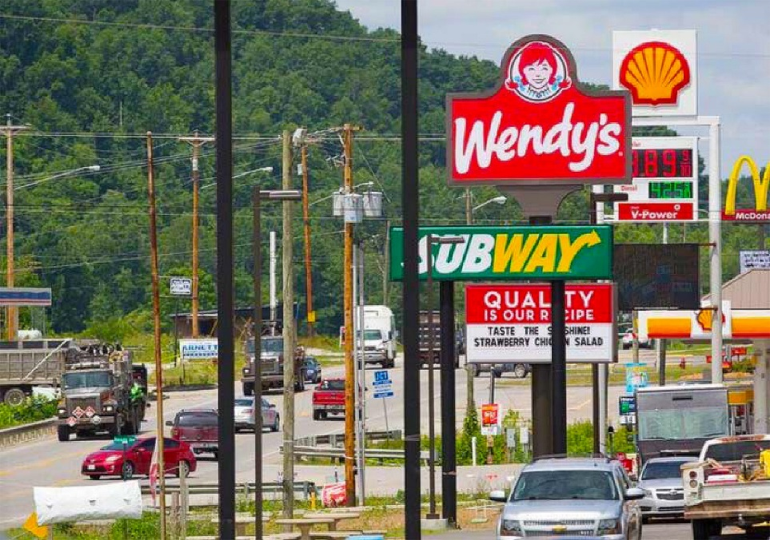
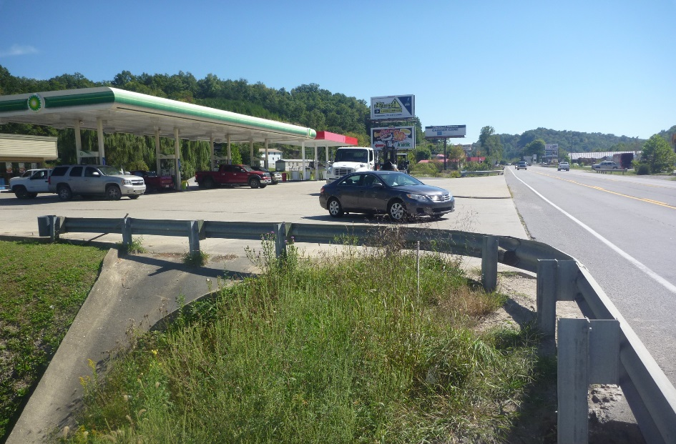
Right of Way Overview
Access Control
97 Parcel to be Acquired
54 Relocations
10 RHP
20 Business
1 Non-Profit
14 Billboards
9 Misc. Moves
How are We Going to Clear in Year?

Slide 9
Proactive communication plan
Weekly Meetings
Streamline Communication
Plan Changes
Reduce number of iterations
Feasibility of changes
Commitment to Sign, Address in MOU
Met Completion Date of June 2016
80 of the 97 parcels acquired

Slide 10
Actual ROW project schedule for completion

Slide 11
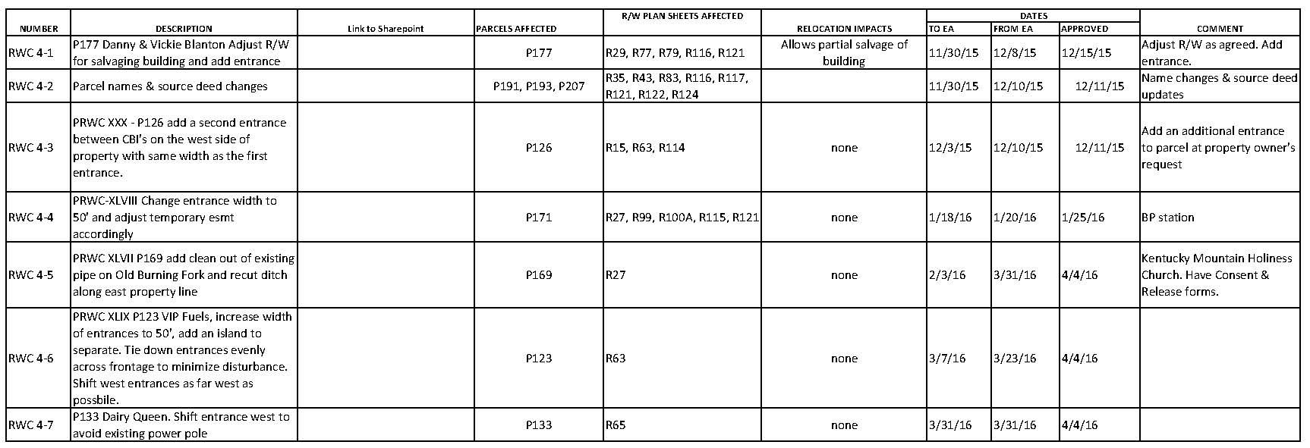
ROW Change Management

Slide 12
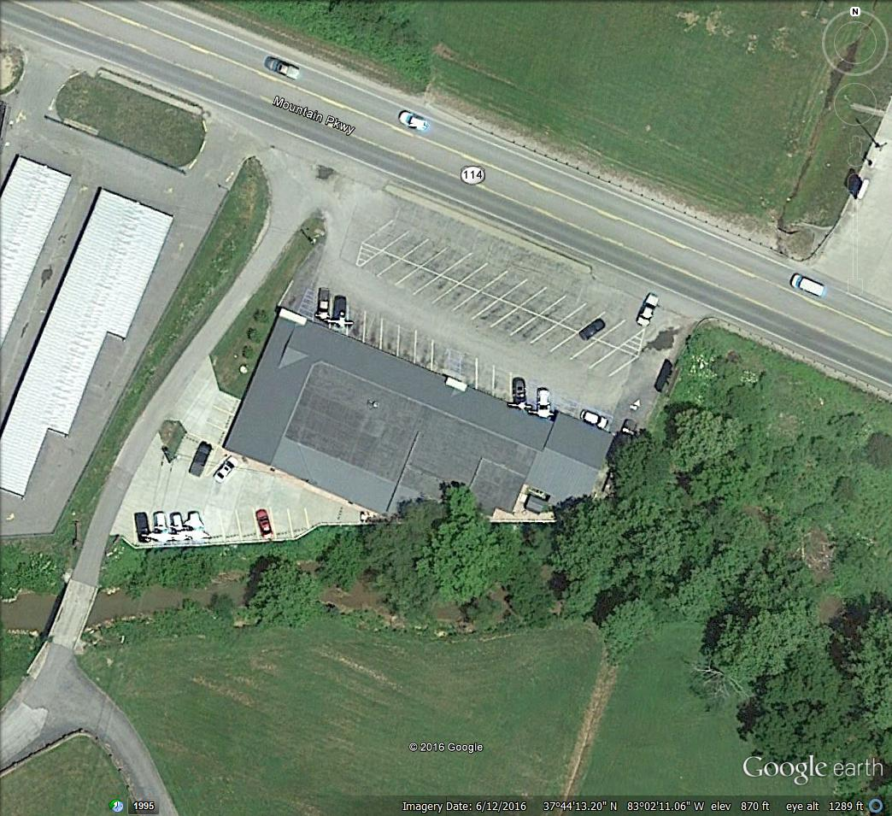
Albaree Health

Slide 13
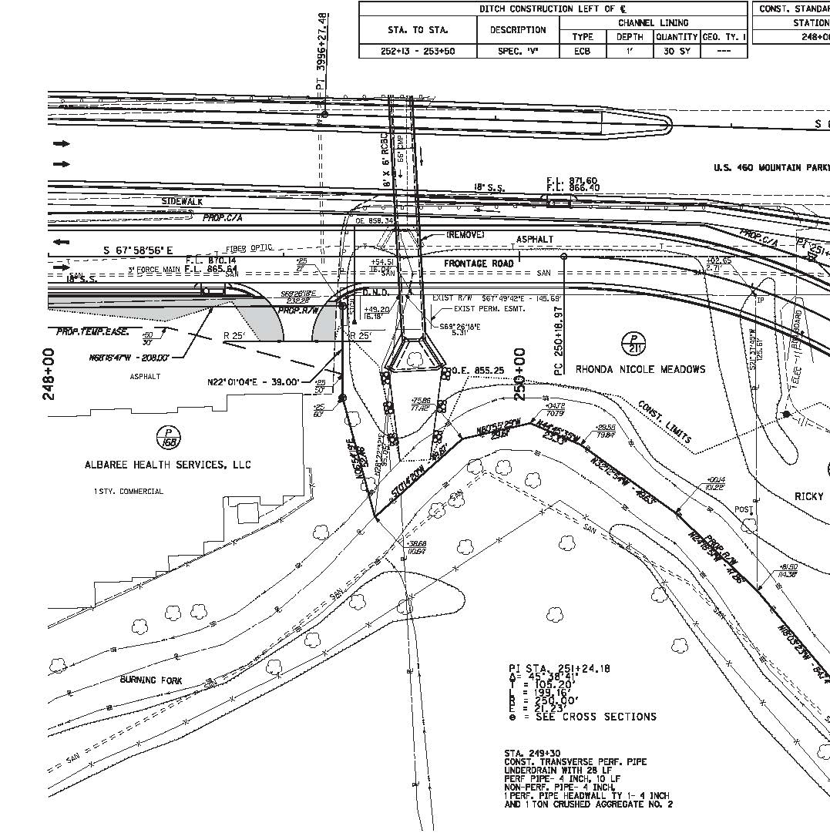
Albaree Health

Slide 14
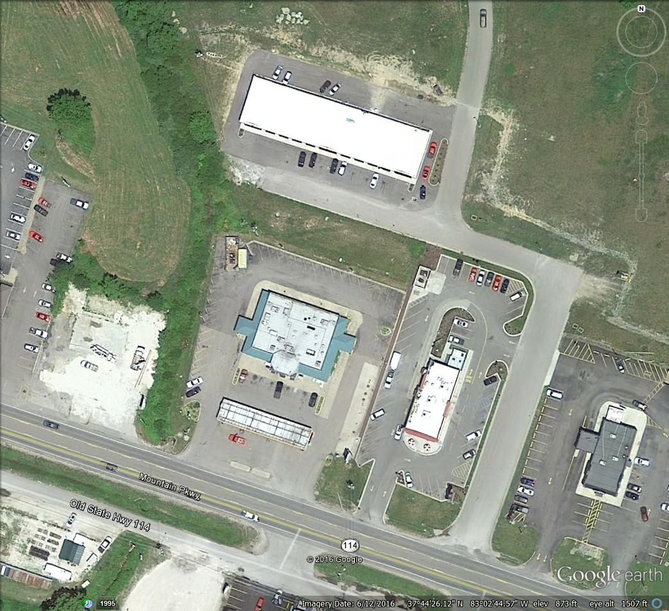
Backage Road “Tweak”

Slide 15
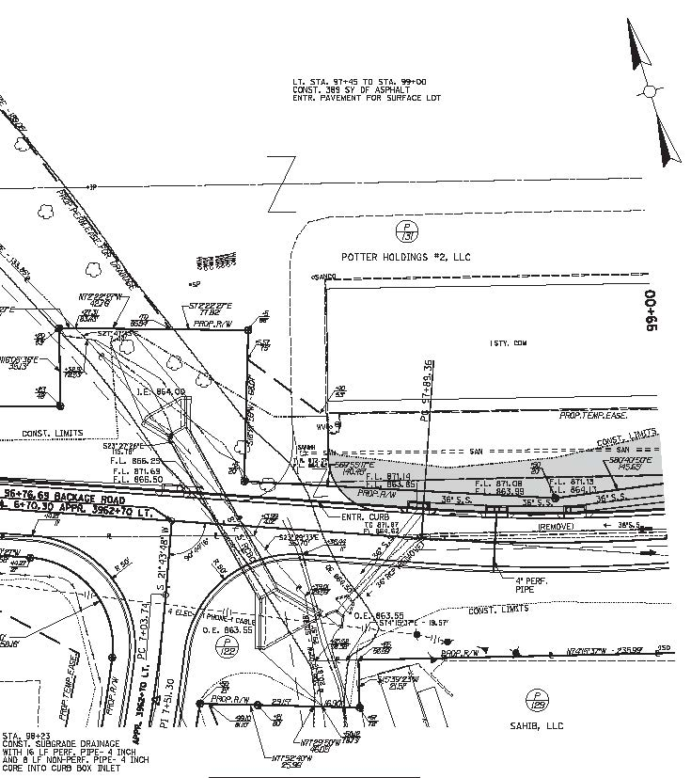
Backage Road “Tweak”

Slide 16
Any questions?
RIGHT OF WAY PLAN TO CONSTRUCTION MOUNTAIN PARKWAY
KYTC Partnering Conference: ROW & U Tracts

